Slide 1
Quantitative tRADING
A brief survey of trading horizons, data, and strategies
BY Leigh Lommen
6/27/17

Slide 2
Background
Options and futures trader in Chicago
Masters in Financial Mathematics
Quantitative Researcher for Trading Education Platform, HF Subadvisor and Research provider funded by Skybridge Capital Partner (host of Wall Street Week’s Partner)
Never had sustained “directional trading” success with out use of computers (or hedging – use of math to hedge)

Slide 3





Taxonomy of different trading strats and their respective time horizons (& Data: The Life blood of a quant)
Ultra HFT
HFT
Stat Arb
CTA
Quant Equity
$$∆t=mS \left(1×{10}^{−3}\right)or$$
$$μS (1×{10}^{−6})$$
$$∆t=days, wks, mos$$
$$∆t=μS \left(1×{10}^{−6}\right)or$$
$$ns (1×{10}^{−9})$$
$$∆t=s, min, days$$
$$∆t=s to mos$$
Tick
Tick
Min & daily

Slide 4
Building trading strategies
Methodologies: Observation, Academic research, fundamental ratios, technical indicators, statistical research, time series analysis, stochastic modeling, pattern recognition, machine learning, AI, etc., etc.

Slide 5
Protocol-Scientific method
Hypothesize
Split data into two samples (train and test-NLP you better know this!) (control and experimental)
Optimize parameters on Training set
Use strategy on test set
Paper trade going forward to see if results are still profitable
Implement with real money using risk control (max DrawDown, # of unprofitable trades, etc.)

Slide 6
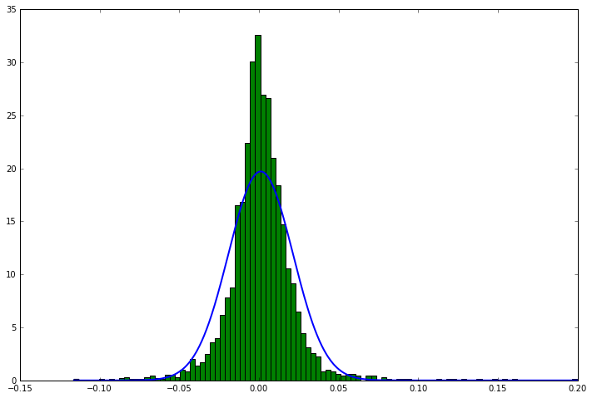
Problem 1: time series is non-stationary and non-normal (returns have fat tails)

Slide 7
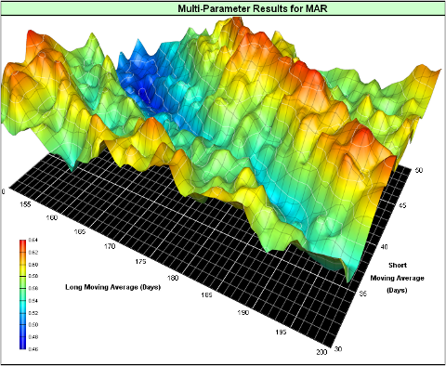
Problem 2: curve fitting

Slide 8
Solutions
Optimize to stable parameters (not local maxima/minima)
Test out of sample and paper trade
Proper position sizing and risk control
Monte Carlo Simulation
Statistical process control

Slide 9

Some quick terminology
Market making – using the bid/ask spread as a competitive advantage and revenue source.
Stat arb – using stats in data to exploit inefficiencies in one or more financial instruments.
Portfolio optimization: $\max{ w′α−\frac{1}{2}λw′Σw}$
S.t. W’ $I_{n}=0$ (directionless portfolio over $∆$t)
Sharpe Ratio = $\frac{E\left[r_{P}\right]−r_{f}}{σ}$
Drawdown: Peak to trough of an equity curve

Slide 10
High Frequency Trading:
Exploits market microstructure for profits
Data used: TAQ (Time and Quote) and NBBO (National Best Bid and Best Offer)
Pros: Tons of Data (Terabytes and Terabytes); A “Cash Cow” when done properly (e.g., Tradeworx has had only a few unprofitable days in its multi-year history) ; Leverage can exceed 10x; Sharpe Ratios can exceed 10
Cons: Competitive and success is often a function of Hardware (Field Gate Process Arrays and Microwave Technology)
Examples: Tradeworx, Virtu Financial, Headlands Technologies, Renaissance Tech, ATD, Knight Trading (Post Mortem)

Slide 11
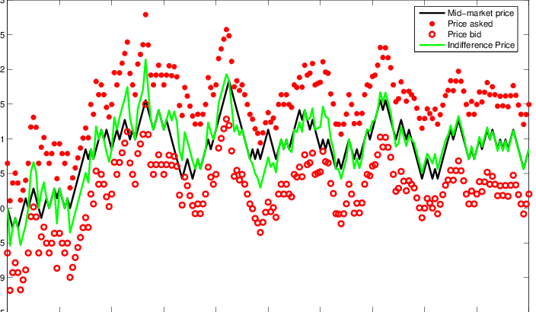
Examples of hft strategies
Bid-Ask Bounce (Buy at Bid/Sell at Offer)-May or may not include rebates

Slide 12
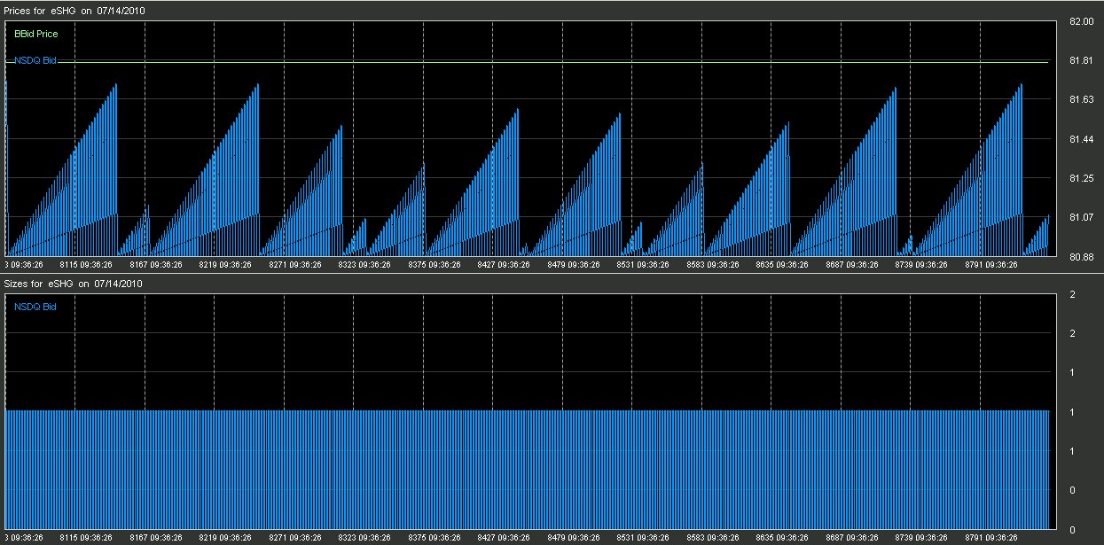
Quote stuffing: illegal?

Slide 13

Statistical arbitrage
Uses anything from tick to daily data.
Exploits inefficiencies in prices, liquidity, fundamentals, and other attributes.
Sample Strategy 1: Mean Reversion
$w_{it}=−\frac{1}{N}\left(R_{it−k}−R_{mt−k}\right),R_{mt−k}$=$\frac{1}{N}Σ_{i=1}^{N}R_{it−k}$
Really just: Buy worst performing stocks relative to market
Short best performing stocks
Market-Neutral portfolio (Longs = Shorts)
THIS STILL WORKS (THOUGH NOT AS WELL)

Slide 14
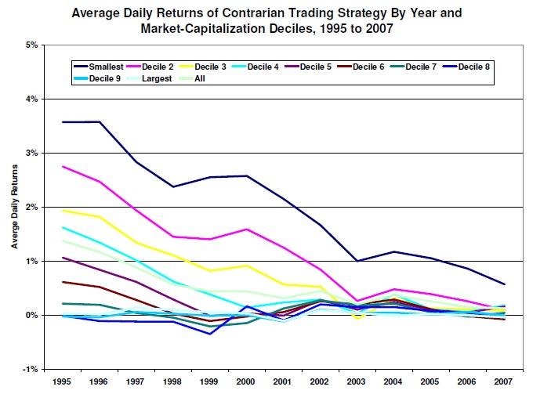
Side note: concept of alpha decay
Mean Reversion over 1 Day Historical Performance

Slide 15


Quant equity
Uses Fundamental Data from financial statements (B/S, I/S, and CF stmt) Utilizing multivariate regression or ranking systems, coupled with historical financial ratios to determine what “has worked” historically.

Slide 16
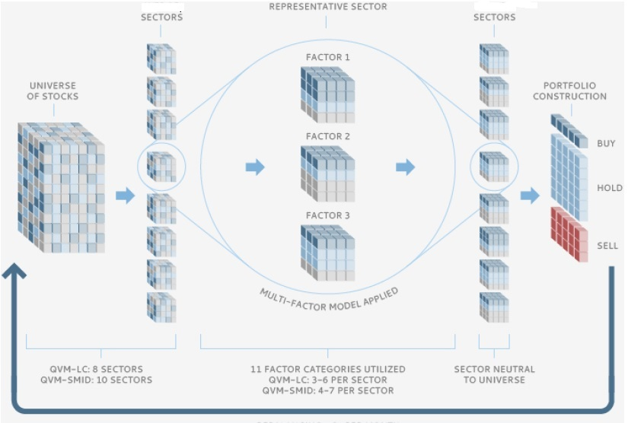
Quant equity models

Slide 17
Proliferation of smart beta models
Market Indices used to construct “Smart Beta” models are not based on price (e.g., DJIA) or market-cap (e.g., S&P 500), but based on fundamental rankings.
Portfolios are frequently rebalanced (from quarterly to daily).

Slide 18
Cta (commodity trading advisor)
Trades can very in duration from seconds to months. Data can be sparse (Trend-Following with daily OHLC) or abundant (tick data) that utilizes stat arb.
http://video.cnbc.com/gallery/?video=3000495019
Data my also me fundamental (Commitment of traders, Grain yields, etc. or Alternative (satellite pics of oil fields, farm lands, etc.)

Slide 19

The rise of alternative data
Price and volume data, as well as fundamental data is OLD HAT!
New horizons:
Email receipts
Satellite Images (of parking lots, oil fields, etc.)
GPS phone data
Social media scraping (sentiment analysis)

Slide 20






Alternative data providers and startups

Slide 21
Where to get started if you are interested
Books: Anything by Ernest Chan, Robert Pardo; Finding Alphas by Igor Tulchinsky
Papers: SSRN (Cliff Asness, Andrew Lo, Marco Avellaneda)
Websites: Quantopian, Quantiacs, Numerai, CloudQuant
Blogs: JonathanKinlay, EP Chan, Trading with Python, Quant at Risk

Slide 22
Platforms
Stat Arb and slower:
Think or Swim (TD Ameritrade)
Interactive Brokers
Stat Arb to HFT:
Lime (Wedbush)
Lightspeed Trading
New Edge

Slide 23
Link to these slides
https://github.com/leighlommen/QuantTrading
Email: Leigh.Lommen@pqam.net

